Slide 1
MGMT 6057 contemporary business management
Module 1b: foundations of business

Slide 2
Objectives
Key terms
Business participants
Functional areas of business
External forces influencing business activities
Three tools for strategic analysis of a business, industry, and/or project
Relevance for project managers

Slide 3
Business terms
Businesses provide goods and services to consumers for the purpose of making a profit
Revenue = income
Profit = revenue – expenses
Entrepreneurs: people who take business risk
Profit: the financial reward for taking risk
Non-profit organizations: are not profit-oriented but function similarly to businesses

Slide 4

Business participants
Owners (shareholders)
Employees
Customers
Other stakeholders
Shareholders
Employees
Vendors
Others
Notes:
Photo CC BY 4.0. Retrieved from: https://commons.wikimedia.org/wiki/Category:Figures_from_Fundamentals_of_Business_by_Skripak

Slide 5
Functional areas of Business
Management
Operations
Marketing
Accounting
Finance
Legal
Human Resources
Information Technology
Etc…
Notes:
Image Source: ‘Fundamentals of Business: Canadian Edition’

Slide 6
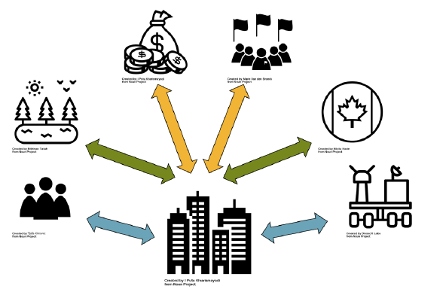
External forces influencing Business activities (the ‘macro business environment’)
Economy
Government
Consumer trends
Technology
Etc.
Notes:
Source: All icons from the Noun Project (https://thenounproject.com/)

Slide 7
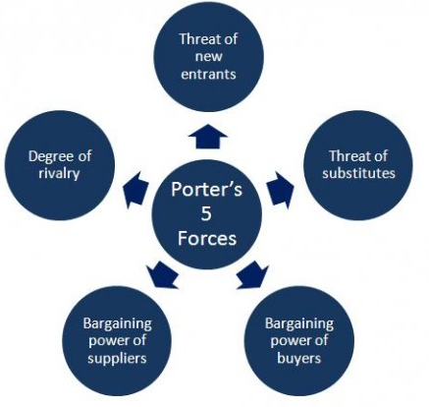
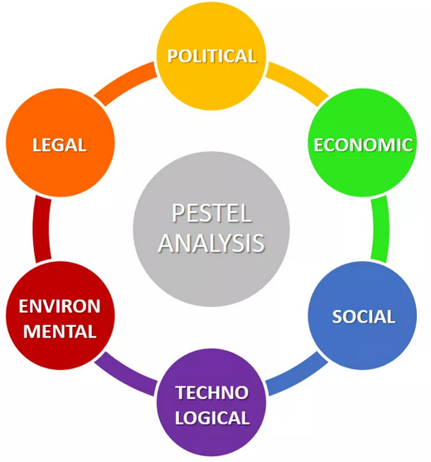
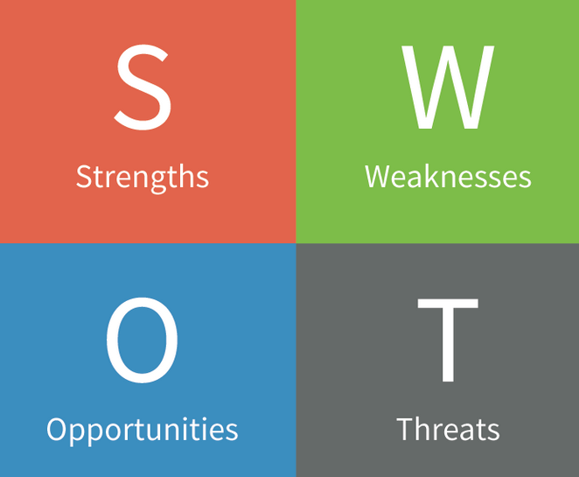
Three common strategic analysis tools: PESTLE, SWOT, porter’s five forces
PESTLE: Political, economics, socio-cultural, technological, legal, environmental factors (see video, )
SWOT: Strengths, weaknesses, opportunities, threats (see video, article)
Porter’s Five Forces: Competitive rivalry, threat of new entrants, power of suppliers, power of buyers, threat of substitutes (see video, )
NOTE: To view the embedded Word files on this slide, switch to slide editor (not slideshow!) mode and double-click on the icons.
Notes:
Sources: https://www.google.com/url?sa=i&rct=j&q=&esrc=s&source=images&cd=&ved=2ahUKEwimp-f8h4fiAhVNu54KHbTRAbcQjRx6BAgBEAU&url=%2Furl%3Fsa%3Di%26rct%3Dj%26q%3D%26esrc%3Ds%26source%3Dimages%26cd%3D%26ved%3D%26url%3Dhttp%253A%252F%252Fnayeems.com%252F2015%252F05%252F28%252Fporters-five-forces-analyzing-the-competition%252F%26psig%3DAOvVaw0UQ39mk2V6yxFYYzDG2vt1%26ust%3D1557237374446140&psig=AOvVaw0UQ39mk2V6yxFYYzDG2vt1&ust=1557237374446140
https://www.google.com/url?sa=i&rct=j&q=&esrc=s&source=images&cd=&cad=rja&uact=8&ved=2ahUKEwiF8u32iIfiAhUEsp4KHUDGB-EQjRx6BAgBEAU&url=http%3A%2F%2Fnexightgroup.com%2Fusing-swot-analysis-to-plan-an-uncertain-future-and-increase-organizational-effectiveness%2F&psig=AOvVaw12bKpmPnGKBLZia7A18Hjz&ust=1557237699558652
https://i0.wp.com/www.business-to-you.com/wp-content/uploads/2016/12/PESTEL-analysis-updated.png

Slide 8
Relevance for project managers
Relevant if you are potential business owner(e.g., freelance event planning, web design, etc.)
Relevant if you will be preparing or understanding the business case for a project
Relevant if you will be managing a project:
Cost management
Stakeholder management
Enterprise environmental factors (EEFs)
Risk Management
Notes:
Relevant if you are potential business owner(e.g., freelance event planning, web design, etc.)
Relevant if you will be preparing or understanding the business case for a project
Relevant if you will be managing a project:
Cost management: Project costs may represent revenues or expenses, depending on the type (role) of project participant
Stakeholder management: Your key stakeholders may be managing their own stakeholders, which affects you indirectly
Enterprise environmental factors (EEFs)
Structures & practices in various functional areas may influence project planning/decision-making/ execution (internal EEFs)
External forces such as economic conditions may influence project planning/decision-making/ execution (external EEFs)
Risk management: Budget pressures, stakeholder influences, EEFs are potential risks in projects

